Slide 1
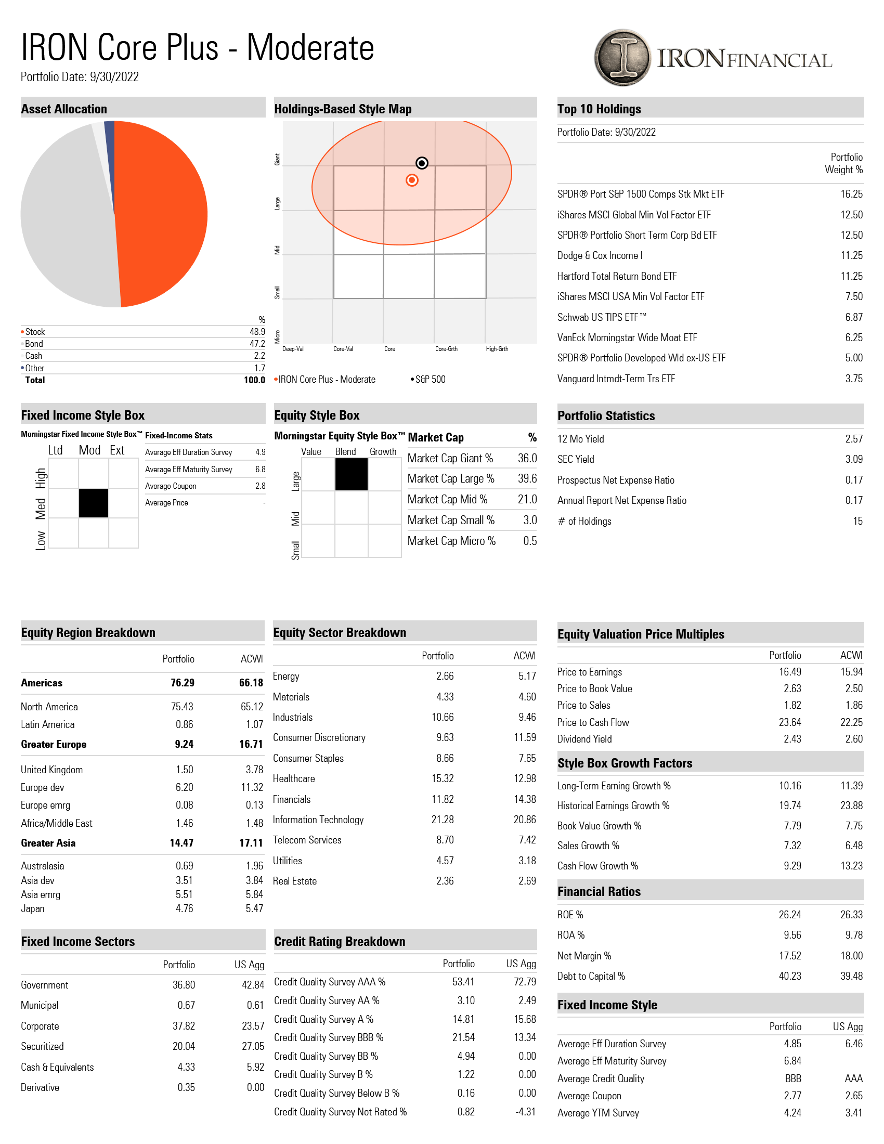

Slide 2
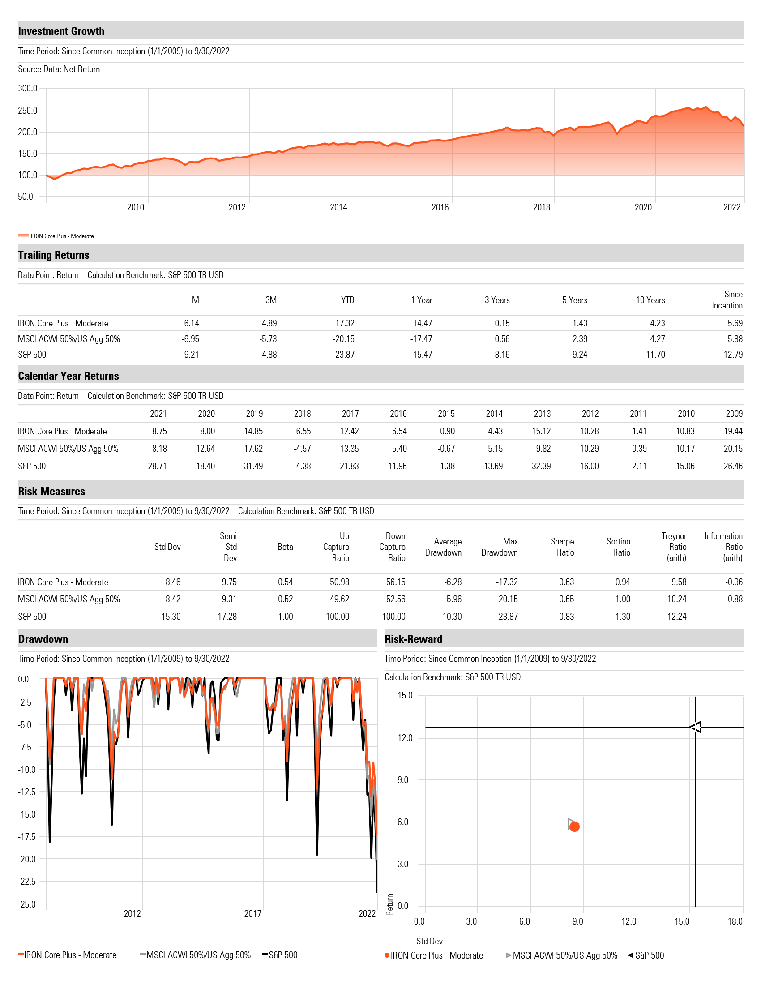

Slide 3
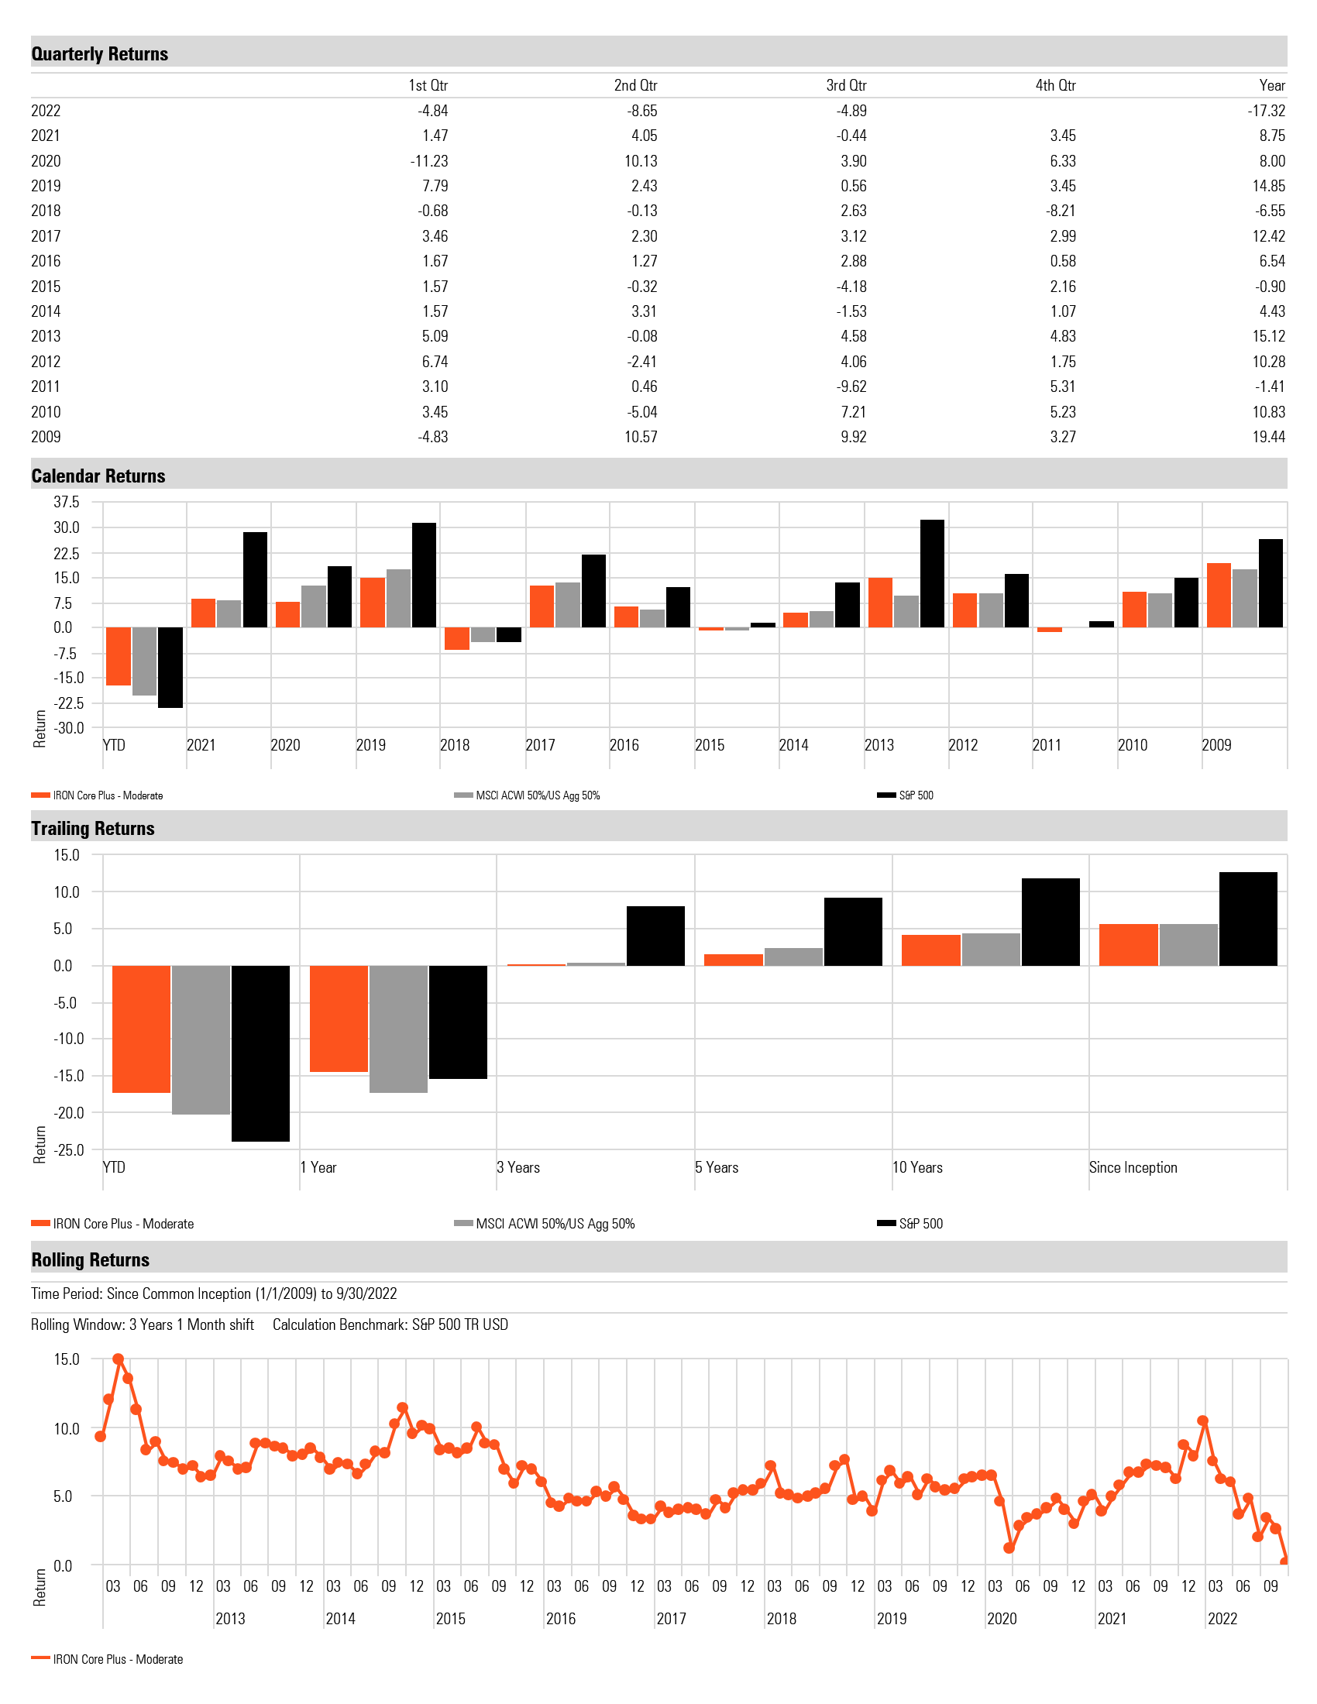

Slide 4
Disclosures
Management fees of 0.50% annually, our highest published fee, have been deducted from the gross performance results for Core Plus portfolios. Client accounts are charged quarterly in arrears based on the quarter-end value adjusted for capital flows. Net returns reflect a monthly accrued deduction of management fees. IRON’s fees are available upon request and may be found in our Form ADV Part 2A disclosure brochure.
Performance is based on a model from 1/1/2009 inception through 12/31/2019. Performance since 1/1/2020 is based on a composite. Inclusion of a managed account within the composite is determined on a monthly basis, requires investment in a given Core Plus portfolio for the entire calendar month, and a beginning monthly balance of at least $50,000. Actual returns for individual client portfolios managed by IRON may vary and do not necessarily coincide exactly with the returns for the model or composite. Actual performance of client portfolios may differ due to the timing related to the actual deployment and investment of a client portfolio, reinvestment of dividends, and client-requested restrictions. Performance for periods longer than a year has been annualized using a geometric mean.
The IRON Core Plus portfolios offer diversified exposure to global equities and fixed income in varying proportions in an attempt to maintain varying levels of correlation to the S&P 500. These provide investors with choices representing different amounts of risk and price volatility. The starting weights of the portfolios are as follows: Conservative Portfolio 20% Equity and 80% Fixed Income, Moderately Conservative Portfolio 35% Equity and 65% Fixed Income, Moderate Portfolio 50% Equity and 50% Fixed Income, Moderately Aggressive Portfolio 65% Equity and 35% Fixed Income, Aggressive Portfolio 80% Equity and 20% Fixed Income.
The S&P 500 Index is a market-capitalization-weighted index of 500 of the largest publicly traded companies listed on US stock exchanges. The S&P 500 Total Return Index is shown for comparison purposes because we feel it is more well understood by investors than a blended benchmark and would therefore better allow investors to compare and contrast various characteristics, such as volatility measures. Benchmark returns do not reflect the deduction of advisory fees. You cannot invest directly in an index.
The MSCI ACWI, or All Country World Index, is designed to represent performance of the full opportunity set of large- and mid-cap stocks across 23 developed and 24 emerging markets. The index is built using MSCI’s Global Investable Market Index (GIMI) methodology.
“US Agg” refers to the Bloomberg US Aggregate Bond Index, which approximates the broad investment grade, US dollar-denominated, fixed-rate taxable bond market. The index includes Treasuries, government-related and corporate securities, agency fixed-rate pass-through [residential] Mortgage Backed Securities (MBS), asset backed securities (e.g. home equity loans, credit card receivables, auto loans), and Commercial Mortgage Backed Securities (CMBS).
The charts, tables, performance, and other information shown are provided to you for informational purposes only and are not intended to be and do not constitute investment or tax advice nor an opinion or recommendation regarding the appropriateness of any investment. The material contained in this document is for general information purposes and is not intended as an offer or a solicitation for the purchase and/or sale of any security or financial instrument, nor is it advice or a recommendation to enter into any transaction. Future returns may differ significantly from past returns due to materially different economic and market conditions. Diversification does not ensure a profit or guarantee against loss.
For more information, visit www.ironfinancial.com

